Slide 1

Streaming into the Future: Mastering Apache Kafka for Real-Time Data Pipelines
Architecture, Use Cases & Why We Need Kafka
Presenter: Sumit

Slide 2
Agenda
Introduction to Apache Kafka
Why Kafka? (The Need & Benefits)
Kafka Architecture Overview
Key Components & APIs
Use Cases and Real-World Examples
Demo/Workshop Outline
Summary & References

Slide 3
What is Apache Kafka?
A distributed event streaming platform for building real-time data pipelines and streaming applications.
Kafka is an open-source distributed event streaming platform used by thousands of companies for high-performance data pipelines, streaming analytics, data integration, and mission-critical applications.
A distributed event streaming platform for building real-time data pipelines and streaming applications.
Core Functions:
Publish/Subscribe to streams of records
Store data durably in an append-only log
Process streams in real time
More than 80% of all Fortune 100 companies trust and use Kafka.

Slide 4
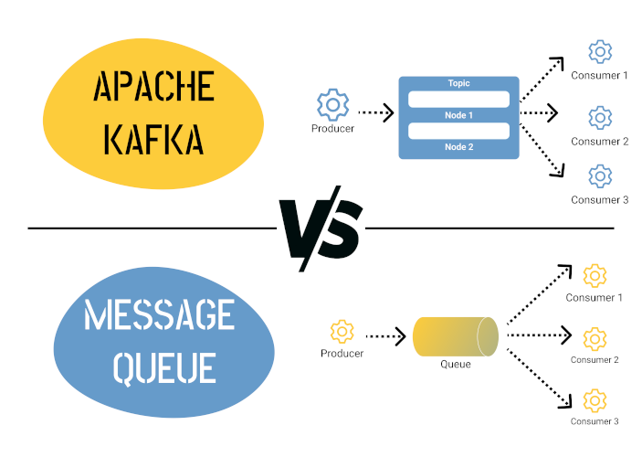
Why Do We Need Kafka?
Challenges in Modern Systems:
High volumes of real-time data
Need for decoupling microservices
Scalability and fault tolerance requirements
Kafka’s Benefits:
High throughput with low latency
Distributed, scalable, and fault-tolerant architecture
Replayability of messages for fault recovery

Slide 5
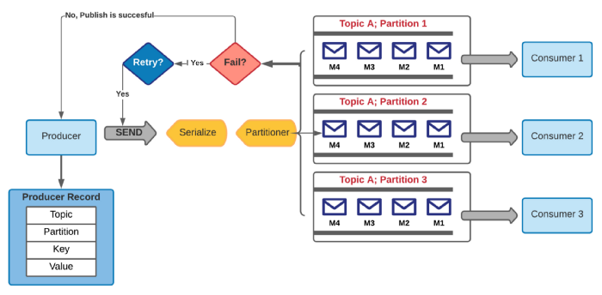
Kafka Architecture Overview
Architecture Layers:
Storage Layer: Distributed commit log (topics & partitions)
Compute Layer: APIs (Producer, Consumer, Streams, Connect)
Main Components:
Brokers (servers forming the Kafka cluster)
Topics and Partitions
Producers & Consumers
Coordination

Slide 6
Key Components of Kafka
Brokers:
Handle read/write, store data, and replicate partitions
Topics & Partitions:
Topics group messages; partitions allow parallel processing
Each partition is an immutable, ordered log with unique offsets
Producers & Consumers:
Producers send data; consumers subscribe and process messages
Coordination:
ZooKeeper (or built-in controller in KRaft mode) for cluster management

Slide 7
Kafka APIs Overview
Producer API:
Publishes records to topics
Consumer API:
Subscribes to topics and processes messages
Streams API:
Enables real-time stream processing with transformations
Connect API:
Simplifies integration with external systems
Admin API:
Manages Kafka clusters and topics

Slide 8
Use Cases & Advantages of Kafka
High Throughput Deliver messages at network limited throughput using a cluster of machines with latencies as low as 2ms.
Scalable Scale production clusters up to a thousand brokers, trillions of messages per day, petabytes of data, hundreds of thousands of partitions. Elastically expand and contract storage and processing.
High availability Stretch clusters efficiently over availability zones or connect separate clusters across geographic regions.
Client Libraries Read, write, and process streams of events in a vast array of programming languages.
Built-in Stream Processing Process streams of events with joins, aggregations, filters, transformations, and more, using event-time and exactly-once processing.

Slide 9
Why kafka for project orion?
Crowd Monitoring:
multiple cameras and environmental sensors around the stadium capture real-time crowd density and movement data.
This information is also ingested into Kafka and processed to monitor crowd flow, detect congested areas, and identify unusual patterns (e.g., rapid dispersal or bottlenecks)
Player Tracking:
Data ingestion
Player insights
Live alerts and visualizations

Slide 10
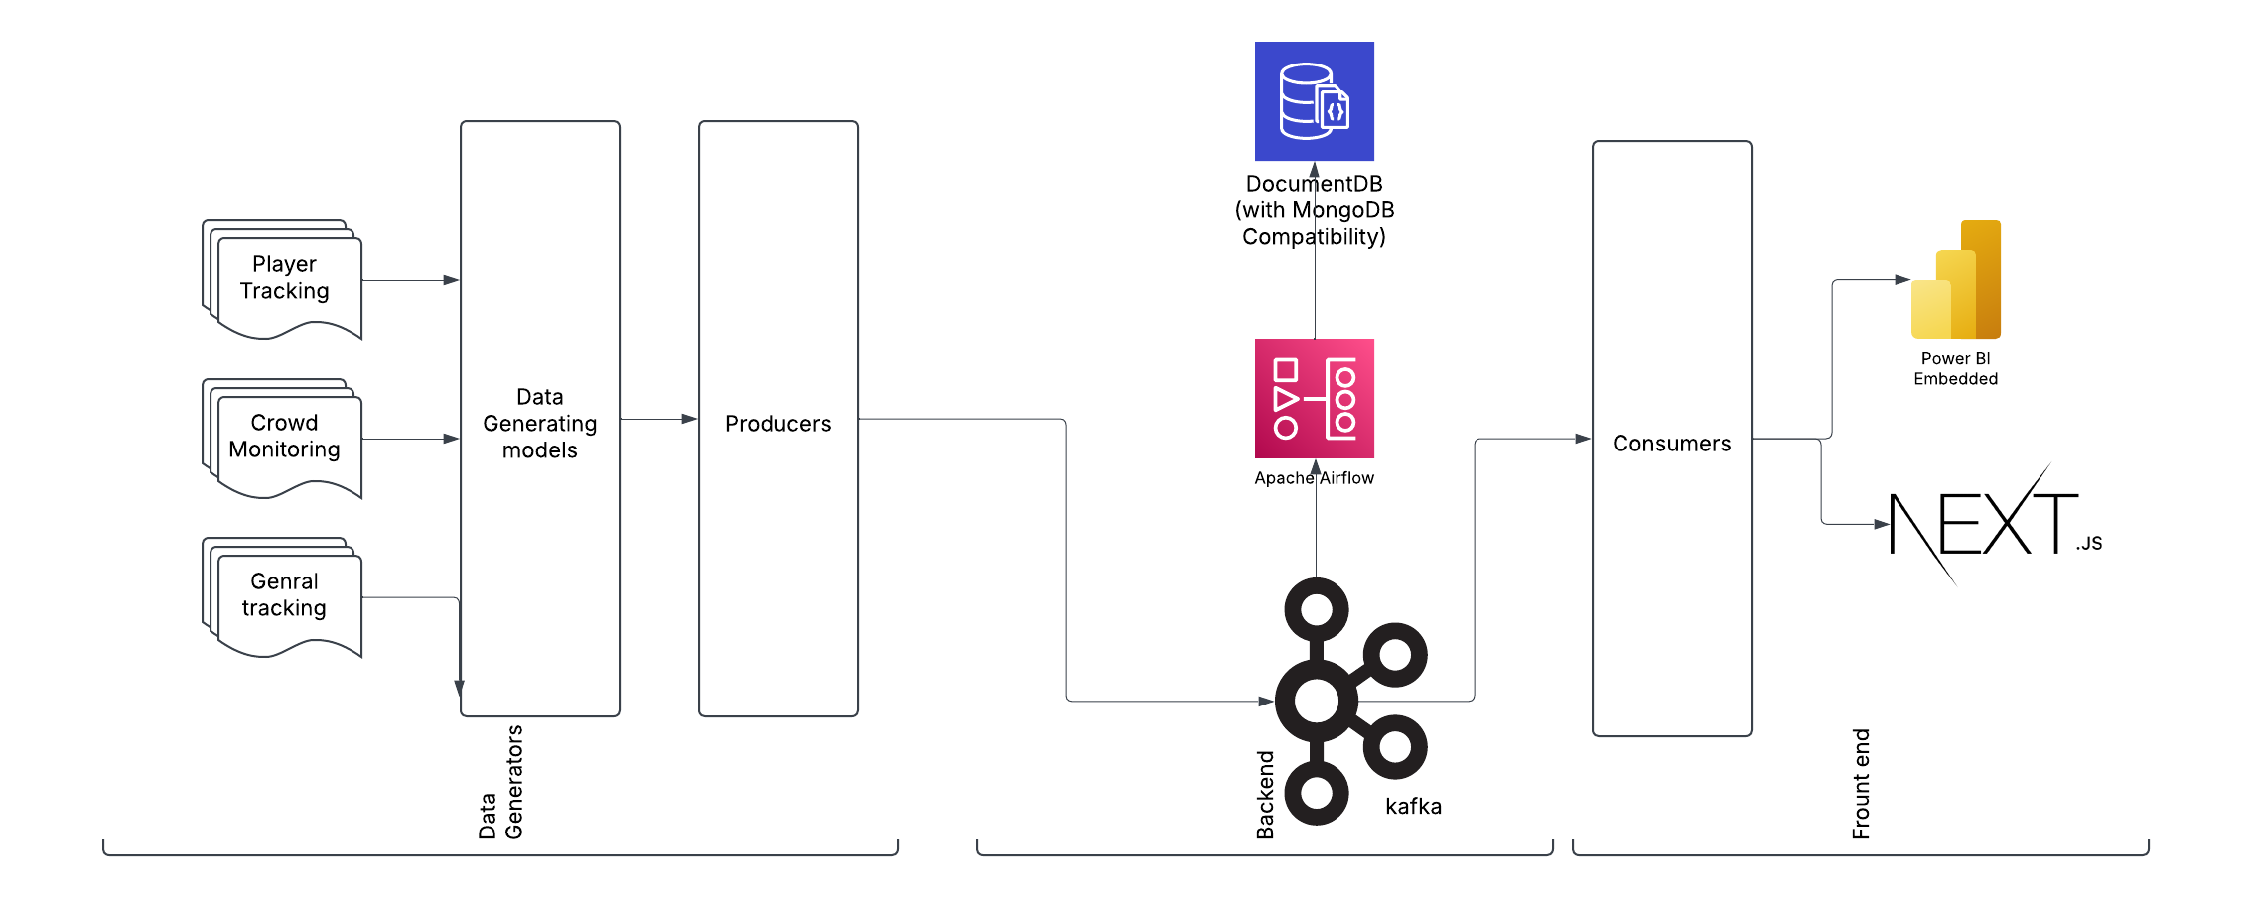
Architecture for backend

Slide 11

Q & A?

